Slide 1

Does Pushing Security on Clients Make Them Safer?
Matthew Traudt and Paul Syverson Center for High Assurance Computer Systems (CHACS)
U.S. Naval Research Laboratory
Washington DC
Notes:
.

Slide 2

“Pushing Security” ???
Protocols that enable a server to instruct clients to behave in a more secure way
Generally requires state to be saved at the client
Look at two web protocols: HSTS and Alt-Svc
Notes:
.

Slide 3
HSTS: Background
HTTP Strict Transport Security (HSTS)
RFC 6797 (Nov 2012)
Support in all modern browsers
“Keep using HTTPS to reach me.”
Two parts: header from webserver and preload list in browser
Header
Preload List
Only trusted when received over TLS
Specifies max-age, includeSubdomains
List comes with browser
Maintained by vendor
Can’t scale to entire web
Strict-Transport-Security: max-age=1800;
The Problem
Notes:
.

Slide 4
HSTS: Problem
Using HTTPS or not for a given
domain is a bit of information
Attack (General)
Always use HTTP links on their website
Embed many resources (images, JS, CSS, etc.) … each at a different subdomain
To start tracking, have some set of the resources send HSTS headers. bit vector
To read the bit vector, monitor the client’s new HTTP/HTTPS usage
Doesn’t always work. Too obvious.
Notes:
.

Slide 5
HSTS: Problem
Attack (Better): Clickjacking
Put HSTS-setting domains in front of the links in the page
Set the state, then redirect to actual content
Even better: chain HSTS-setting domains
15-20 bits of state can be set each time, depending on browser
Current location | Bit | Redirect Target
Click for cat pics |  | 01.foo.com
01.foo.com | 1 (did set HSTS) | 02.foo.com
02.foo.com | 0 | 03.foo.com
03.foo.com | 0 | 04.foo.com
04.foo.com | 1 (did set HSTS) | 05.foo.com
05.foo.com | 1 (did set HSTS) | catpics.com
Final encoded bit vector: 10011
Notes:
.

Slide 6
HSTS Problem Documented
HSTS Supports Targeted Surveillance, FOCI 2018 (our work)
Protecting Against HSTS Abuse, Webkit 2018
HSTS Super Cookies, Greenhalgh 2015
RFC 6797 § 14.9, 2012
Chrome Fixes STS Privacy Issue, 2010
Nothing has changed since FOCI 2018
Notes:
General attack is not novel, but our clickjacking is. Prior work didn't consider 3rd party tracking or clickjacking.

Slide 7
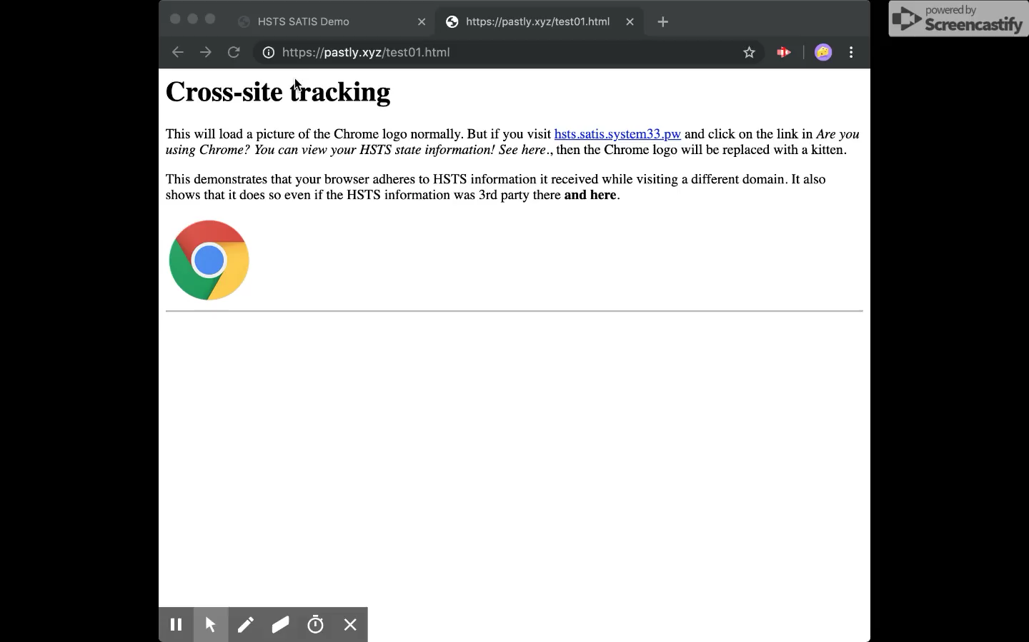
HSTS Tracking Demo
Notes:
.

Slide 8
Does Pushing Security on Clients Make Them Safer?
Matthew Traudt and Paul Syverson Center for High Assurance Computer Systems (CHACS) | U.S. Naval Research Laboratory
HSTS
Alt-Svc
Notes:
Pause for questions

Slide 9
Alt-Svc: Background
HTTP Alternative Services (Alt-Svc)
RFC 7838 (Apr 2016)
Limited support
“Here’s another way to get this content. Please use it in the future instead.”
Load balancing, opportunistic/improved encryption
Alt-Svc: h2=”04cd89.fbcdn.net:443"; ma=600;
Notes:
.

Slide 10
Alt-Svc: Problem
The webserver can send the client to
any* domain—even a unique one
Attack
To start tracking, give the new client a unique Alt-Svc header
Watch as they continue to use their unique Alt-Svc to fetch resources from your domain
It’s that easy
* As long as the Alt-Svc can present a valid TLS certificate containing the origin domain
Notes:
Onion Alt-Svc. TB users are more concerned about privacy/security. FB/Cloudflare use it. Would be easy to spin up new onions for each new user. Also no record in DNS or anything, making it harder to detect. Plug SAT domains here as more secure way of going over onion transparently. Our extension allows trusting of individual alt-svc while blocking by default

Slide 11
Alt-Svc Problem Documented
This talk, 2019
RFC 7838 § 9.4, 2016
Notes:
Also, no one seems to acknowledge 3rd party

Slide 12
Attack Efficacy
 | HSTS 1st Party | HSTS 3rd Party | Alt-Svc 1st Party | Alt-Svc 3rd Party
Firefox 68.0 | ✅ | ✅ | ✅ | ✅
Tor Browser 8.5.3 | ✅ | ❌ | ✅ | ❌
Chrome 75.0.3770.100 | ✅ | ✅ | ⚠️ | ⚠️
Safari 12.1.1 | ✅ | ✅ | ❌ | ❌
✅ attack works. ❌ doesn’t work. ⚠️ probably works.
Notes:
First pause for questions.
Chrome to a 1st approx. hasn't really implemented Alt-Svc so it isn't vulnerable.

Slide 13
Clearing State In Firefox 68.0
 | HSTS | Alt-Svc
Forget about this site | ✅ | ❌
Clear recent history (default) | ❌ | ✅
Clear recent history (everything) | ✅ | ✅
Closing browser completely | ❌ | ❌
✅ removes HSTS/Alt-Svc state. ❌ state remains.
Notes:
Even worse: tables for other browsers would look different

Slide 14
HSTS vs Alt-Svc
Both push security on clients, but issues are different
HSTS
Easy to block
Easier to detect
May not be smart to block
Alt-Svc
Easy to block
Hard to detect
Safe to block
Notes:
“smart”: opening clients up to MitM attacks

Slide 15
Questions
In general, pushing security on clients is probably a good idea. We just need to be careful about our protocol designs.
How can a server provably push security to all users in the same way?
How can we manage this dichotomy between security and trackability?
How can we make ”global” security improvements such as HSTS’s preload list scale to the Internet?
Matthew Traudt
matthew.traudt@nrl.navy.mil
Notes:
.

